Slide 1
Comparing AI Agents for Connect 4:
Minimax vs. Monte Carlo Tree Search
Team Matrix
Kiranmai Modugu
Greeshma Chanduri
Pravalika Kamineni

Slide 2
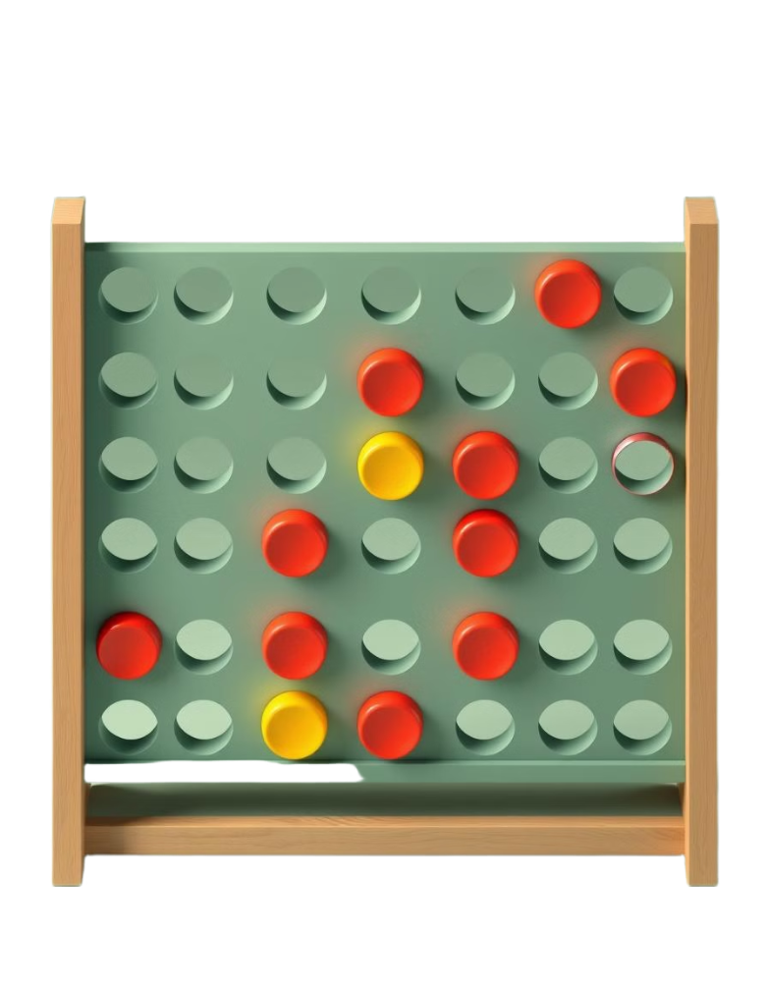
Project Overview
This project aims to develop AI agents for the game Connect 4 using two popular search algorithms—Minimax with Alpha-Beta Pruning and Monte Carlo Tree Search (MCTS). The goal is to evaluate their performance based on win rate, decision time, and strategic behavior. The project ensures originality through a custom evaluation heuristic and an interactive GUI built with Pygame.
Research Question
We hypothesize that Minimax with Alpha-Beta Pruning will achieve a higher win rate and faster decision time than both MCTS.

Slide 3
Methodology
Minimax with Alpha-Beta Pruning:
Depth-limited search: Depth = 6 (adjustable via UI)
Custom heuristic: Prioritizes central columns, three-in-a-row patterns, and threat blocking
Efficient node pruning via alpha-beta pruning
Game board represented using a 6x7 NumPy matrix
Monte Carlo Tree Search (MCTS):
Uses UCT (Upper Confidence Bound for Trees) strategy
Runs 1000 simulations per move (adjustable)
Simulations prioritize blocking opponent wins and maximizing potential connects
Same 6x7 board structure for consistency
Originality:
Custom heuristic function in Minimax (e.g., weighted scoring of potential connections)
Pygame GUI with:
Real-time move visualization
Difficulty slider (to adjust depth or simulation count)
Timing and move logs for both algorithms

Slide 4
Tools & Technologies
Programming Language: Python
Libraries: NumPy, Pygame, Math, Random, Time
Development Environment: VS Code
Version Control: GitHub

Slide 5
Project Deliverables
Source code (GitHub repository).
Project report detailing implementation and evaluation.
Demo video showcasing gameplay.
Relevance
Code demonstrates Connect 4 AI implementation and GUI. Report evaluates performance. Video provides visual proof.

Slide 6
Evaluation Methodology
Win/Loss Rate: Based on head-to-head matches (Minimax vs. MCTS), repeated over multiple games
Decision Time: Measured for each move.
Pruning Efficiency: For Minimax, measure the percentage of branches pruned
Simulation Efficiency: For MCTS, analyze how increasing simulation count affects win rate and decision time

